Slide 1


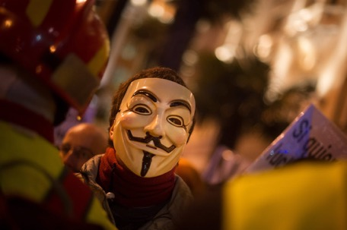
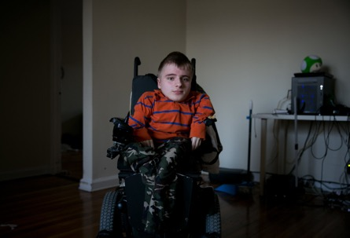
Spikes in Boards
The view from web archives
Shawn M. Jones
Los Alamos National Laboratory Library Prototyping Team
Web Science and Digital Libraries Research Group
CS895: Web Archiving Forensics Fall 2020

Slide 2


WARNING: is a terrible place
I tried to keep most of the screenshots in this presentation clean.

Slide 3
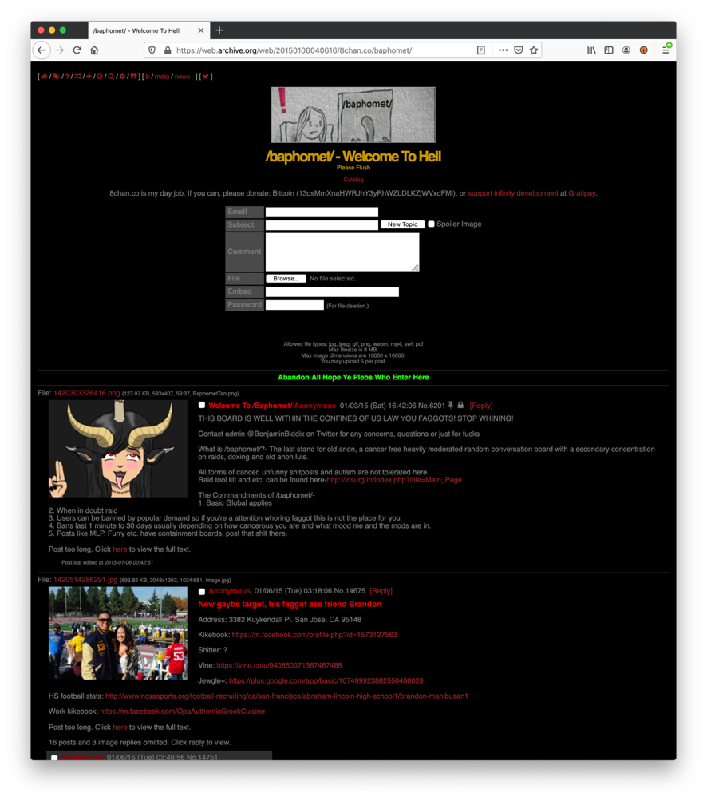
8chan is an imageboard web site
It has various names: 8chan, ∞chan, Infinitechan, Infinitychan
Imageboard = forum + images
8chan has boards (forums) with names like /baphomet/, /v/, and /pol/
each board consists of anonymous posts by users
https://web.archive.org/web/20150106040616/8chan.co/baphomet/

Slide 4
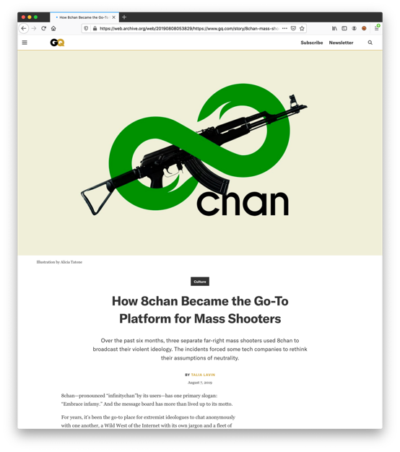
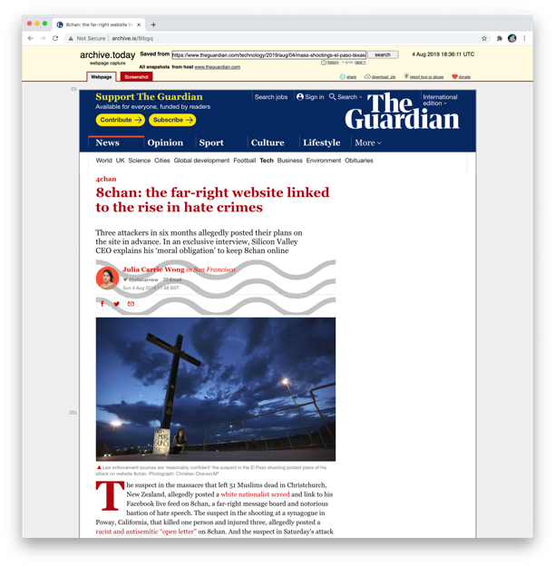
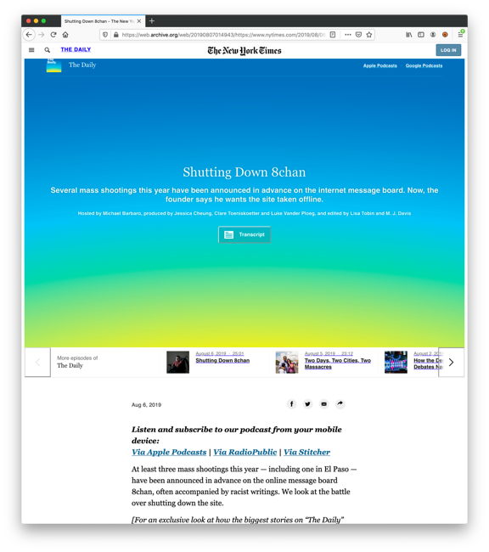
8chan is best known for its connection to recent far-right mass shootings
https://web.archive.org/web/20190808053829/https://www.gq.com/story/8chan-mass-shooters
http://archive.is/9Ibgq
https://web.archive.org/web/20190807014943/https://www.nytimes.com/2019/08/06/podcasts/the-daily/8chan-el-paso-shooting.html

Slide 5
But it is not just linked to mass shootings, Wikipedia lists 11 events tied to the far-right users on 8chan
Event | Date | Descrption
Gamergate | 2014/9/18 | 4chan banned Gamergate discussion, moved to 8chan
Swatting | 2015/1 | 8chan users called police to terrorize Gamergate victims
Child Pornography | 2015/8 | 8chan was banned from Google search for Child Porn
Donald Trump’s “Star of David” Image | 2016/6/22 | First recorded post of image to Internet
QAnon | 2018/3/14 | Reddit bans QAnon follower subreddit
QAnon | 2018/9/12 | Reddit bans QAnon second follower subreddit
QAnon users flock to 8chan | 2018/9/19 | 8chan must upgrade their servers for the new load
Louisiana Antifa List | 2018/9 | 8chan released a hoax list of Antifa members and it was used by Lousiana Police
Christchurch mosque shooting | 2019/3/15 | shooter posted manifesto to 8chan prior to event
Poway synagogue shooting | 2019/4/27 | shooter open letter and livestream to 8chan
El Paso shooting | 2019/8/3 | shooter posted manifesto to 8chan prior to event

Slide 6
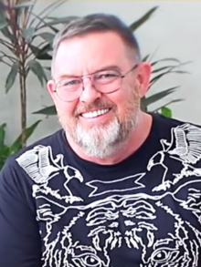
8chan history
October 2013
4chan banned many Gamergate advocates because they were harassing victims
Frederick Brennan, Gamergate advocate, created 8chan in response
April 2016
Brennan stepped down
Jim Watkins became the new owner
Brennan continued working for 8chan until December 2018
October 2014
Brennan moves to the Philippines and to work on 8chan full time
January 2015
8chan changes its domain name from 8chan.co to 8ch.net after their domain registrar terminates their contract over child pornography found on the site
August 2019
After the El Paso shooting, Brennan called for Watkins to take the site offline
Watkins refused and sued Brennan for “cyber libel” under Philippine Law
Brennan fled the Philippines after a court issued an arrest warrant
Cloudflare terminated its contract with 8chan on August 5, 2019
Tucows terminated its support as 8chan’s domain name registrar
8chan is now accessible on the Darknet via TOR
Brennan now advocates against 8chan
Frederick Brennan
Jim Watkins

Slide 7
Events tied to

Slide 8
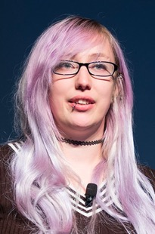
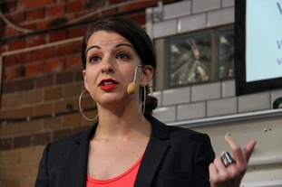
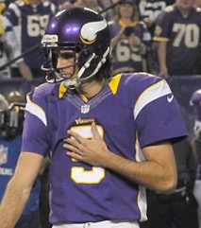
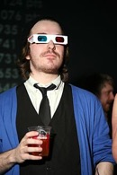
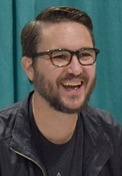
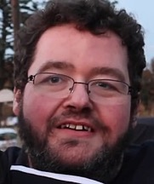
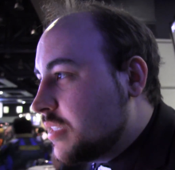

Gamergate was an online harassment campaign targeted at women in the gaming industry, and those who defended them
Targets received rape and death threats.
Some targets were victims of doxxing.
Gamergate supporters coordinated harassment via 4chan, 8chan, and Reddit.
It moved to the /gamergate/ board of 8chan.
Anita Sarkeesian
(target)
Chris Kluwe (target)
Phil Fish (target)
Zoë Quinn
(target)
TotalBiscuit (target)
Wil Wheaton (target)
Boogie2988 (target)
and more...
Felicia Day (target)
Brianna Wu
(target)

Slide 9
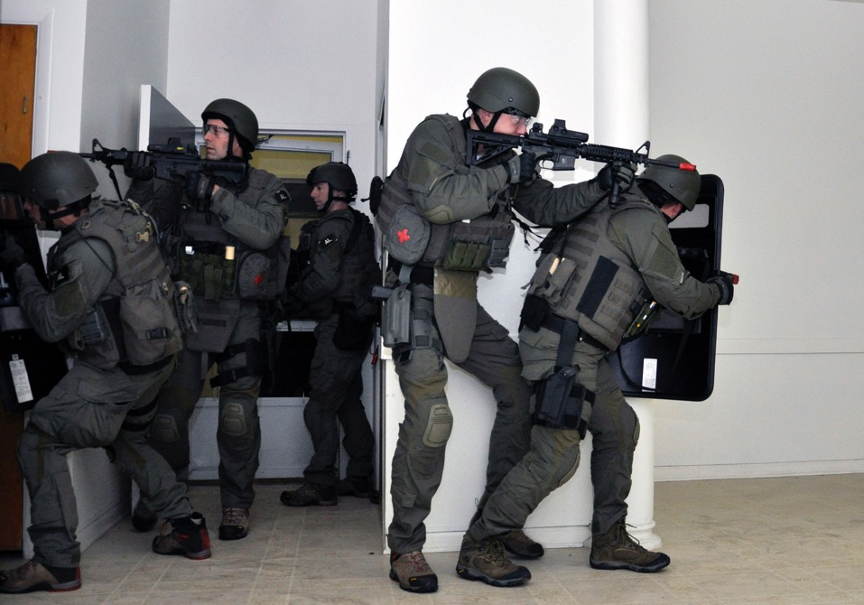
Swatting
A popular online harassment tactic used by 8chan members is to make a false report to law enforcement.
In some cases, a SWAT team has appeared at the victim’s home.
In January 2015, the /baphomet/ board was used to coordinate swatting against victims in Portland, Seattle, and Burnaby, British Columbia.
The victims were often those who criticised Gamergate proponents and protected Gamergate victims.

Slide 10
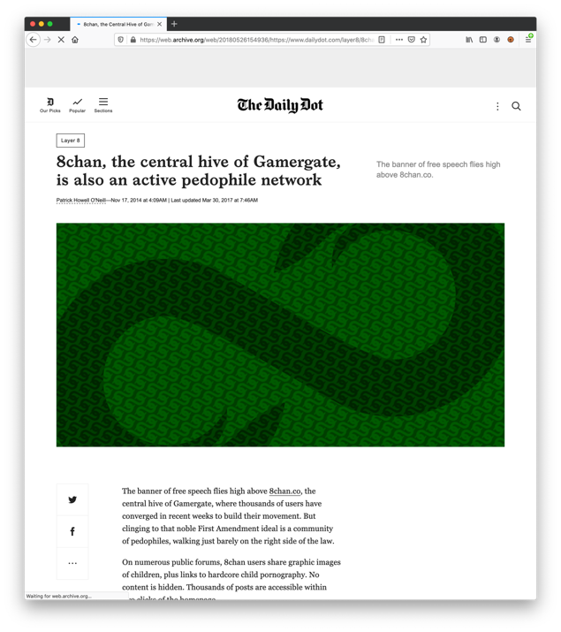
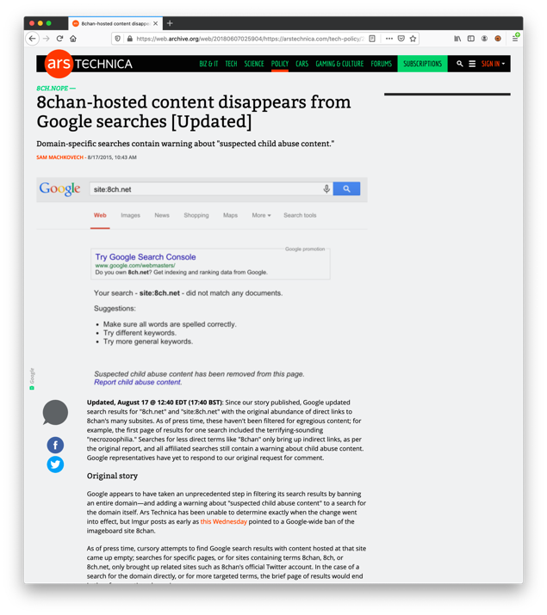
In August 2015, 8chan was banned from Google Search over child pornography discovered on the /doll/ board.
https://web.archive.org/web/20180526154936/https://www.dailydot.com/layer8/8chan-pedophiles-child-porn-gamergate/
https://web.archive.org/web/20180607025904/https://arstechnica.com/tech-policy/2015/08/8chan-hosted-content-disappears-from-google-searches/

Slide 11
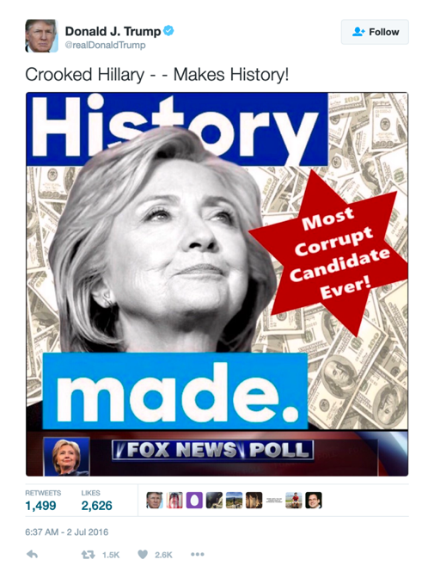
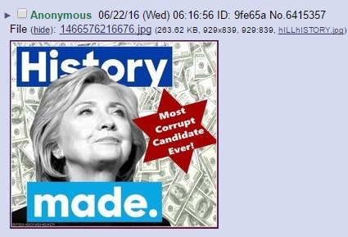
Donald Trump’s “Star of David” Tweet came from content posted to 8chan’s /pol/ board
Jews consider the image of the sacred Star of David over money to play to racist stereotypes and thus is anti-semitic.
According to USA Today the tweet was deleted from @realDonaldTrump within 2 hours.
There is a copy in Archive.Today.
This image originated on 8chan.
https://web.archive.org/web/20160702192338/https://www.usatoday.com/story/news/politics/onpolitics/2016/07/02/donald-trump-deletes-anti-clinton-star-david-tweet-after-criticsm/86635324/
https://web.archive.org/web/20190222100531/https://www.mic.com/articles/147711/donald-trump-s-star-of-david-hillary-clinton-meme-was-created-by-white-supremacists
http://archive.md/20160702135209/https://twitter.com/realDonaldTrump/status/749235486389043200

Slide 12
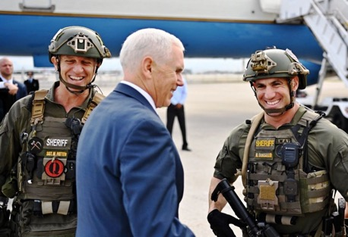
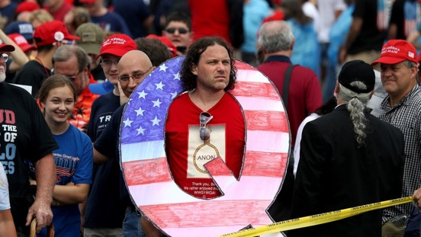
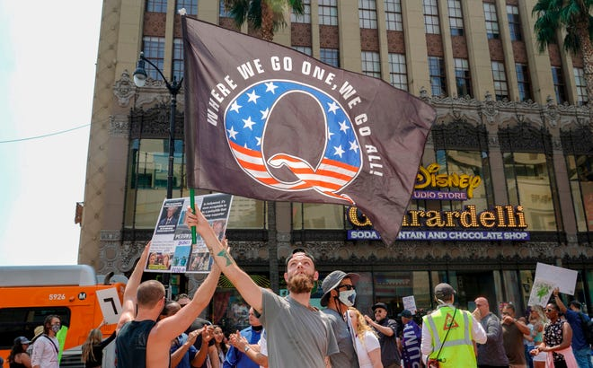
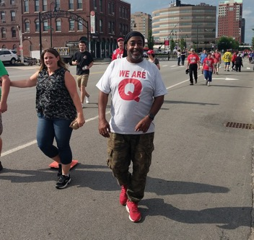
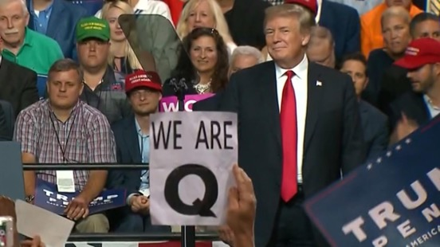
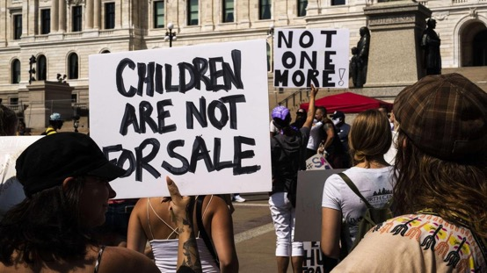
QAnon advocates moved to 8chan in 3 waves in 2018 after their subreddits were banned by Reddit

Slide 13
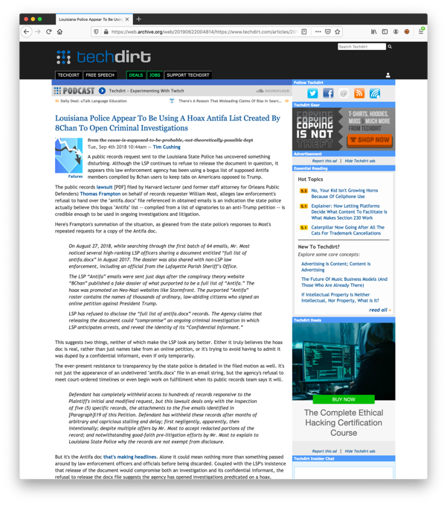
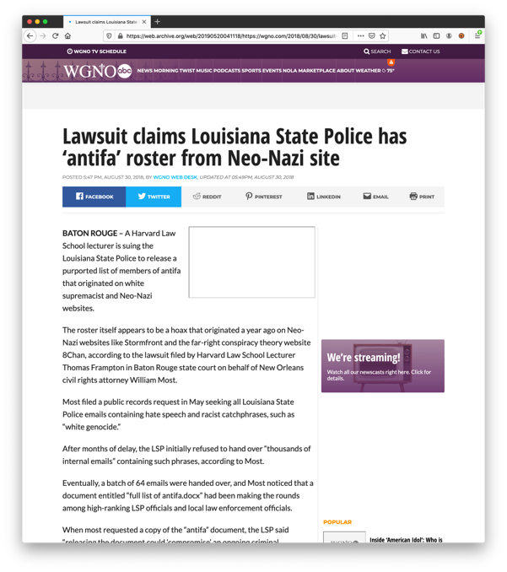
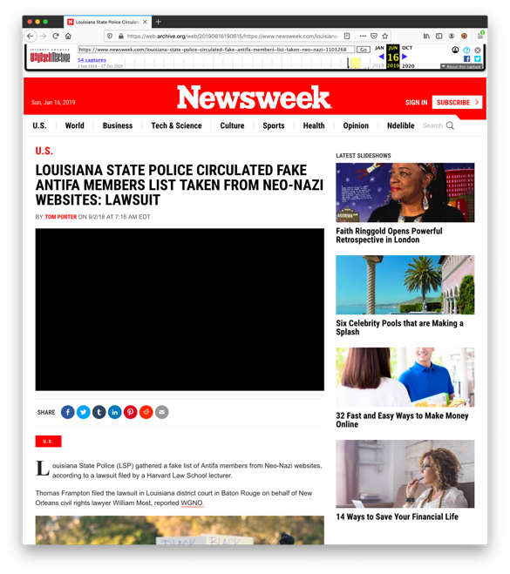
In 2018, Louisiana state police began investigating people found on a fake list of Antifa supporters that had been posted to 8chan
https://web.archive.org/web/20190616190615/https://www.newsweek.com/louisiana-state-police-circulated-fake-antifa-members-list-taken-neo-nazi-1101268
https://web.archive.org/web/20190622004814/https://www.techdirt.com/articles/20180902/08580340566/louisiana-police-appear-to-be-using-hoax-antifa-list-created-8chan-to-open-criminal-investigations.shtml
https://web.archive.org/web/20190520041118/https://wgno.com/2018/08/30/lawsuit-claims-louisiana-state-police-has-antifa-roster-from-neo-nazi-site/

Slide 14
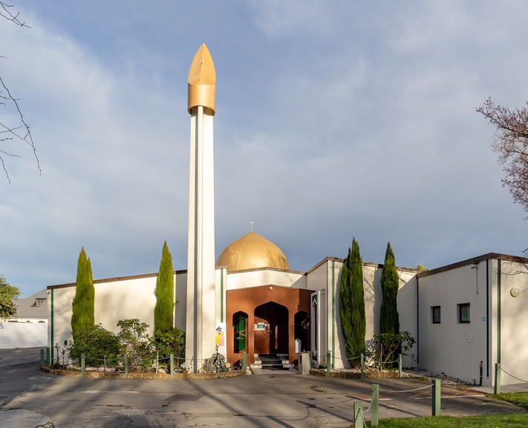
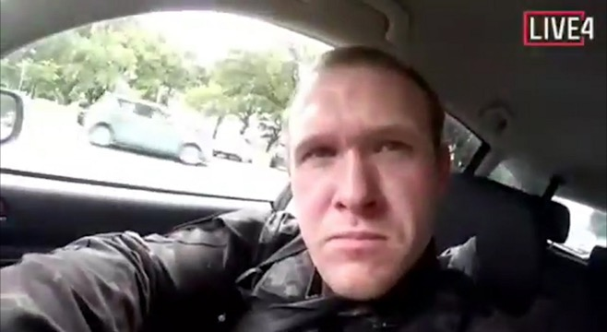
The gunman of the Christchurch mosque shooting on March 15, 2019, posted his manifesto to /pol/
Brenton Harrison Tarrant
(gunman)
Muslims praying
(target)

Slide 15

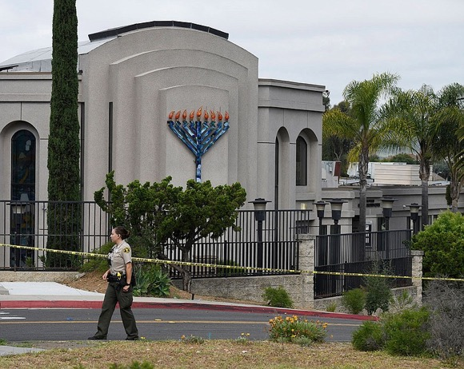
The gunman of the Poway synagogue shooting on April 27, 2019, posted his manifesto to /pol/
John Timothy Earnest
(gunman)
Jews praying
(target)

Slide 16
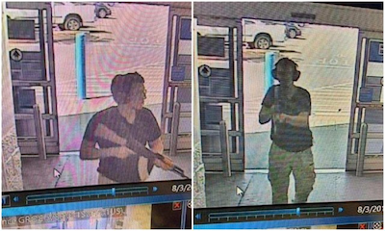
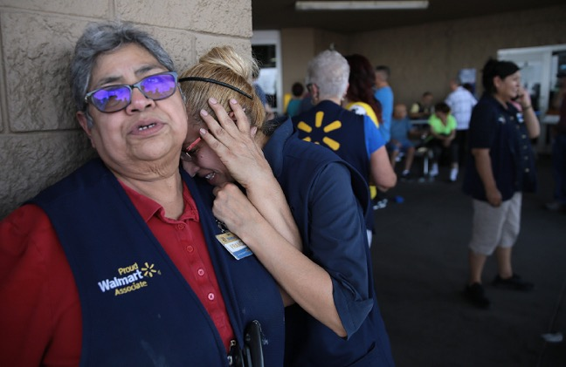
The gunman of the El Paso shooting on August 3, 2019, posted his manifesto to /pol/
Patrick Crusius
(gunman)
Latinos
(Target)

Slide 17
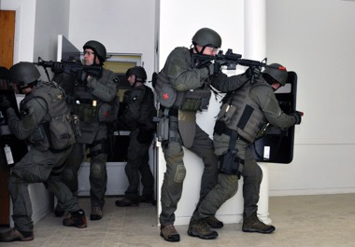

Can we map increases in activity in 8chan to any of these events?

Slide 18
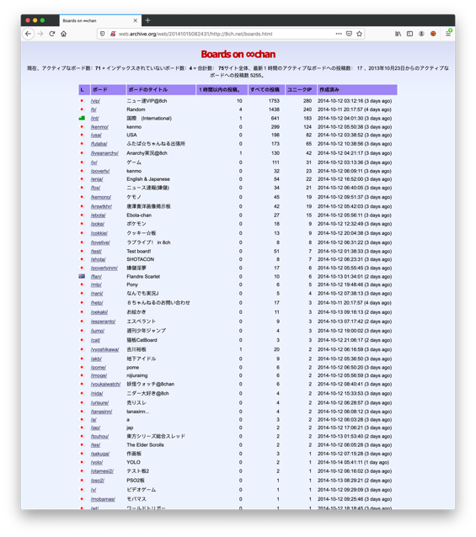
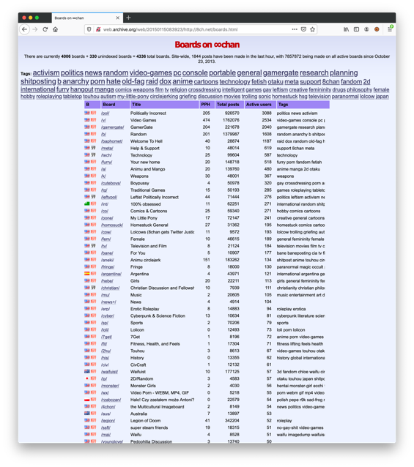
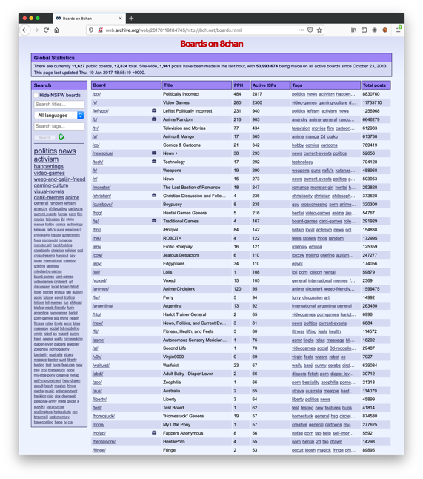
8chan’s board page has changed little over time, making it an easy scraping target
2014
2015
2017
http://web.archive.org/web/20141015082431/http://8ch.net/boards.html
http://web.archive.org/web/20150115083923/http://8ch.net/boards.html
http://web.archive.org/web/20170119184745/http://8ch.net/boards.html

Slide 19
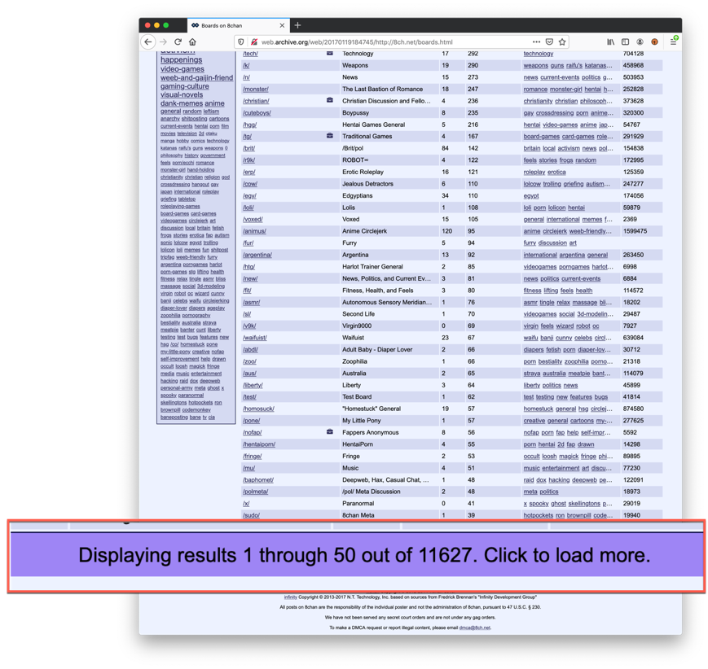
While scraping is easy, getting a complete list of statistics for all boards is not
The web archive did not fully capture this list of boards. Newer versions of the board page have a “load more” link at the bottom.
Clicking to load more does not work.
This gives us good statistics for popular boards, but nothing for other boards that have been reported in the news, like /doll/.
If we have no data for a board, it was not necessarily deleted. It just was no longer present on the initial boards page.
http://web.archive.org/web/20170119184745/http://8ch.net/boards.html

Slide 20
Methods
 | Count
Mementos reported | 1393
Failed Downloads | 58
Non 200 Status | 107
Successful Downloads | 1228
I ran Memgator to find any and all mementos associated with http://8ch.net/boards.html
I downloaded the mementos while honoring 503s and retry-after headers
I wrote a scraper to extract table headers and values from each memento
 | Count
Unscrapeable | 165
8chan issue during capture | 10
Mementos Left | 1053

Slide 21
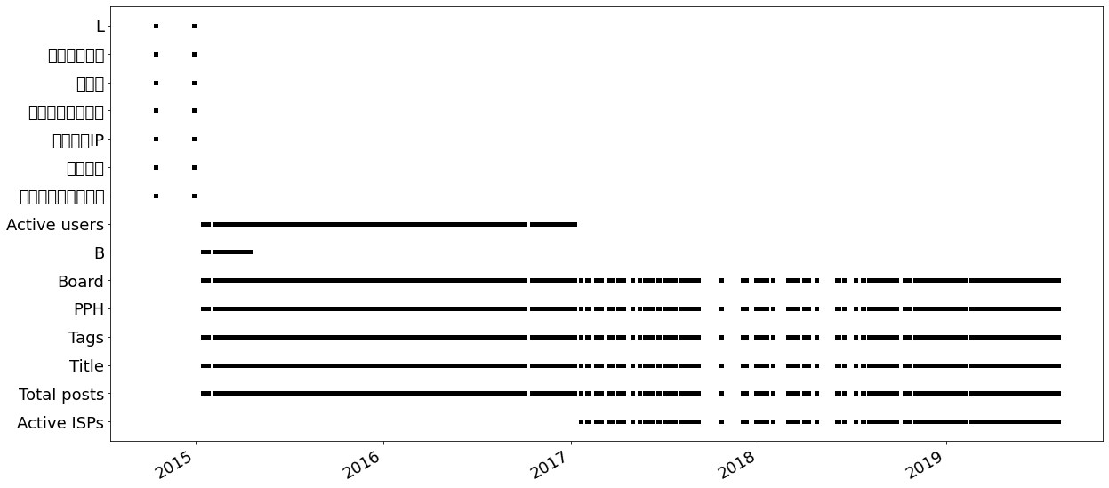
8chan’s boards change headers over time which makes comparing pages a little challenging
すべての投稿
ボード
ボードのタイトル
ユニークIP
作成済み
１時間以内の投稿

Slide 22
To compare different boards to each other, I had to create a controlled vocabulary for measuring changes across mementos
Heading | Meaning | Controlled Name | Included in Study with Controlled Name | Date of Disappearance with no replacement
L | Location Country |  |  | after Dec. 28, 2014
ボード | Board | Board ID | X
ボードのタイトル | Board Title | Board Title | X
１時間以内の投稿。 | Posting Within 1 Hour | Post Per Hour | X
すべての投稿 | All Posts | All Posts | X
ユニークIP | Unique IPs |  |  | after Dec. 28, 2014
作成済み | Created |  |  | after Dec. 28, 2014
B | Location Country |  |  | after Apr. 16, 2015
Board | Board | Board ID | X
Title | Board Title | Board Title | X
PPH | Posts Per Hour | Post Per Hour | X
Total Posts | All Posts | All Posts | X
Active Users | Active Users |  |  | before Jan. 1, 2015; after Jan. 6, 2017
Tags | Tags |  |  | before Jan. 1, 2015; after Aug. 6, 2019
Active ISPs |  |  |  | before Jan. 1, 2017; after Aug 6, 2019

Slide 23
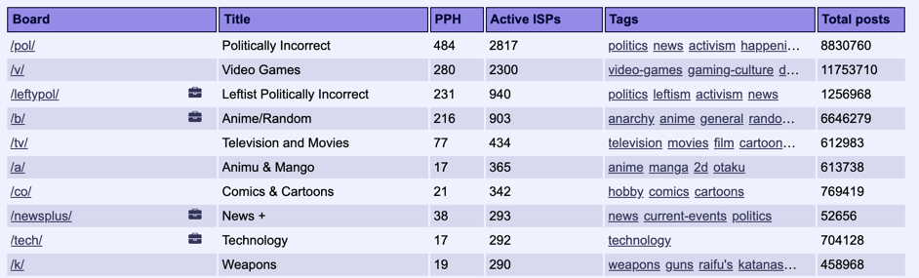
The board, title, PPH, and total posts fields appear, in some form, on all mementos of 8chan
Rank is how close to the top the board appears
Total posts shows the growth of a board over time but does not indicate a spike in activity.
PPH (Posts Per Hour) shows a spike in activity at a given moment.

Slide 24
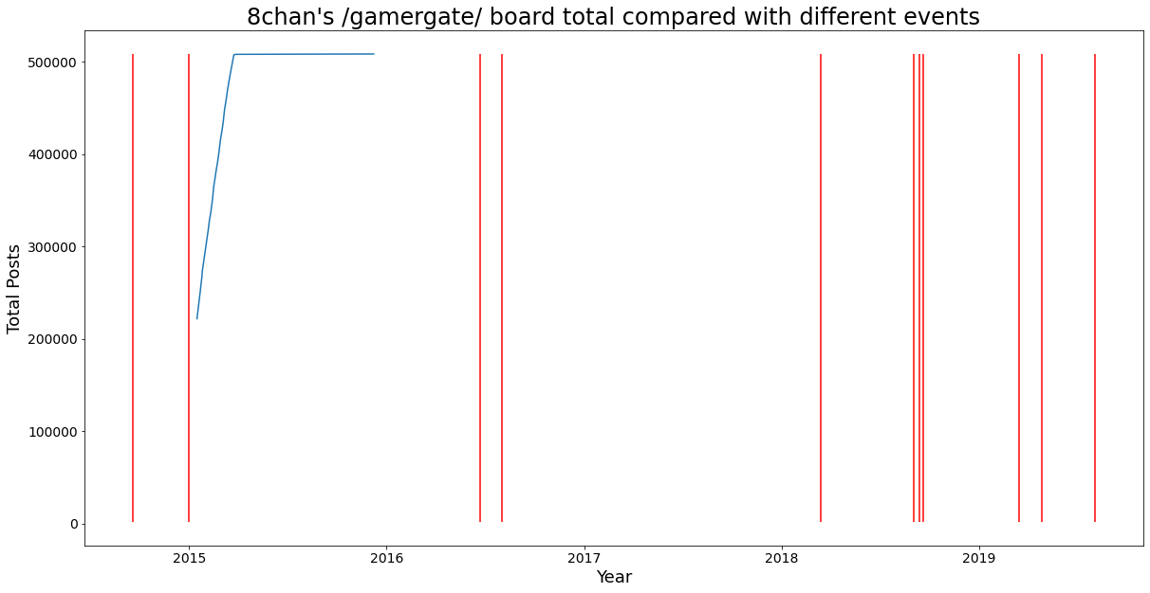
The /gamergate/ board’s total number of posts plateaus in 2016
Christchurch
shooting
Poway
shooting
El Paso
shooting
Gamergate
Swatting
Louisiana
hoax
antifa
Trump “Star of David”
QAnon
Child Porn
Red lines indicate events.

Slide 25
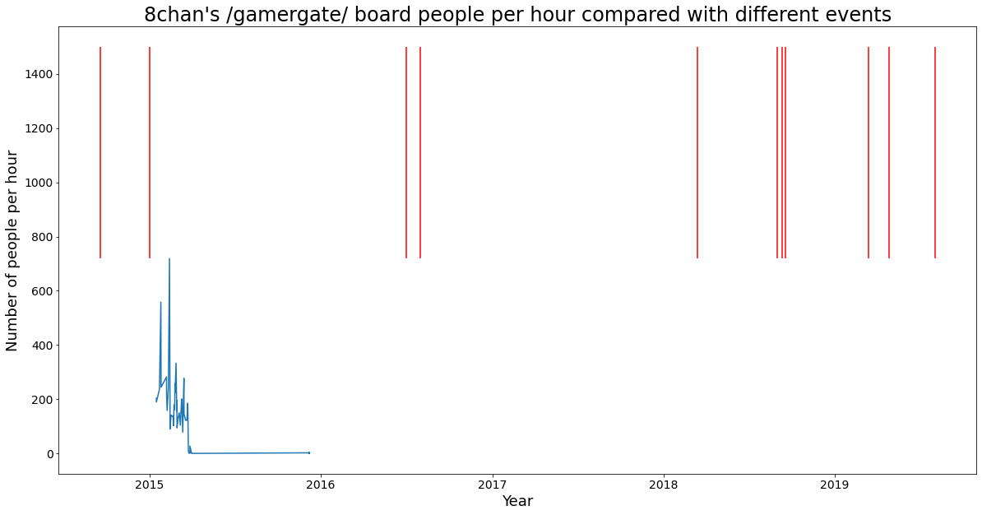
/gamergate/ has activity after the board moves from Reddit, but has no new posts before 2016
Louisiana
hoax
antifa
Christchurch
shooting
Poway
shooting
QAnon
El Paso
shooting
Swatting
Child Porn
Trump “Star of David”
Gamergate
Red lines indicate events.

Slide 26
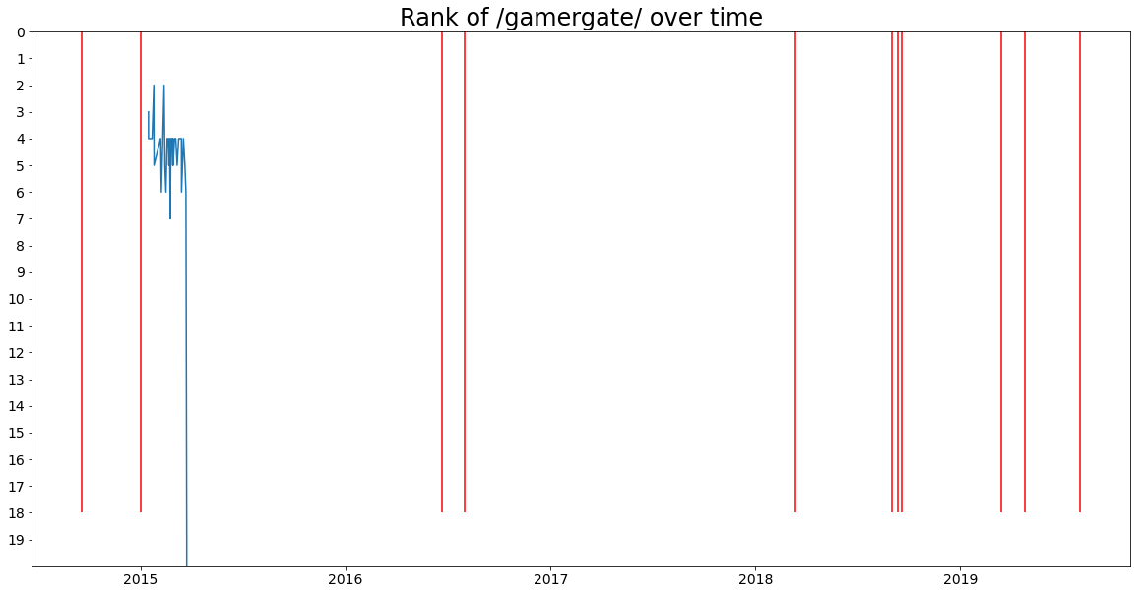
/gamergate/ started dropping in popularity in 2015, after the swatting incidents
Christchurch
shooting
Poway
shooting
El Paso
shooting
Gamergate
Swatting
Child Porn
Trump “Star of David”
Louisiana
hoax
antifa
QAnon
Board
Rank
on
Front
Page
Red lines indicate events.

Slide 27
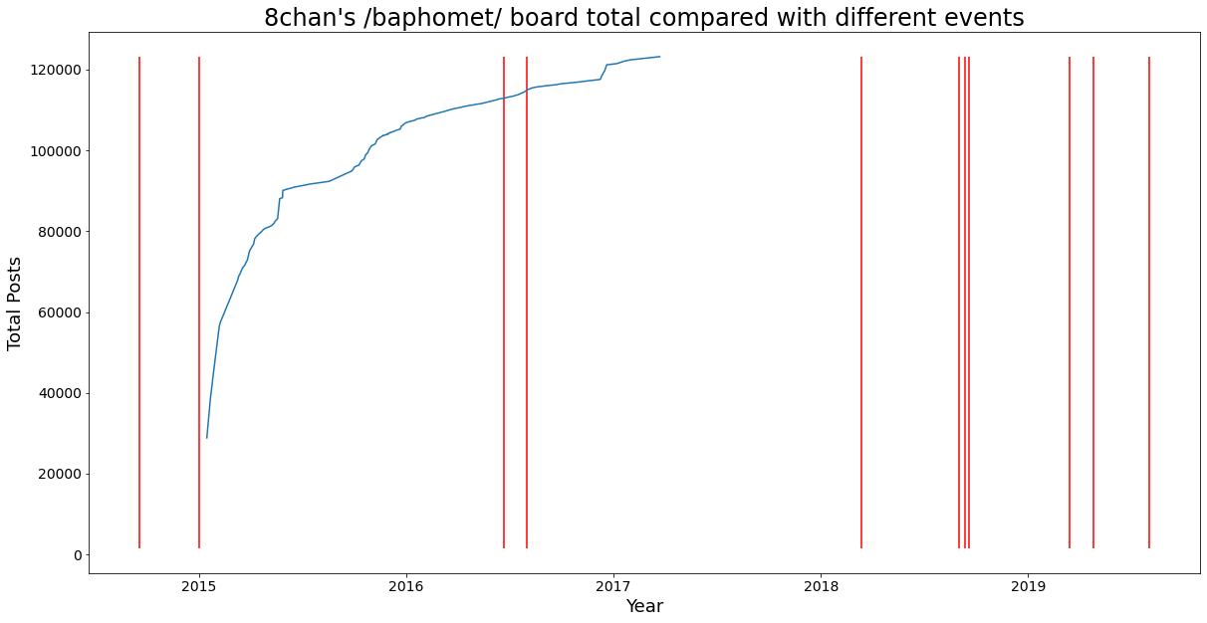
/baphomet/, also associated with Gamergate, grew until early 2017
Christchurch
shooting
Louisiana
hoax
antifa
Poway
shooting
Gamergate
Swatting
El Paso
shooting
QAnon
Trump “Star of David”
Child Porn
Red lines indicate events.

Slide 28
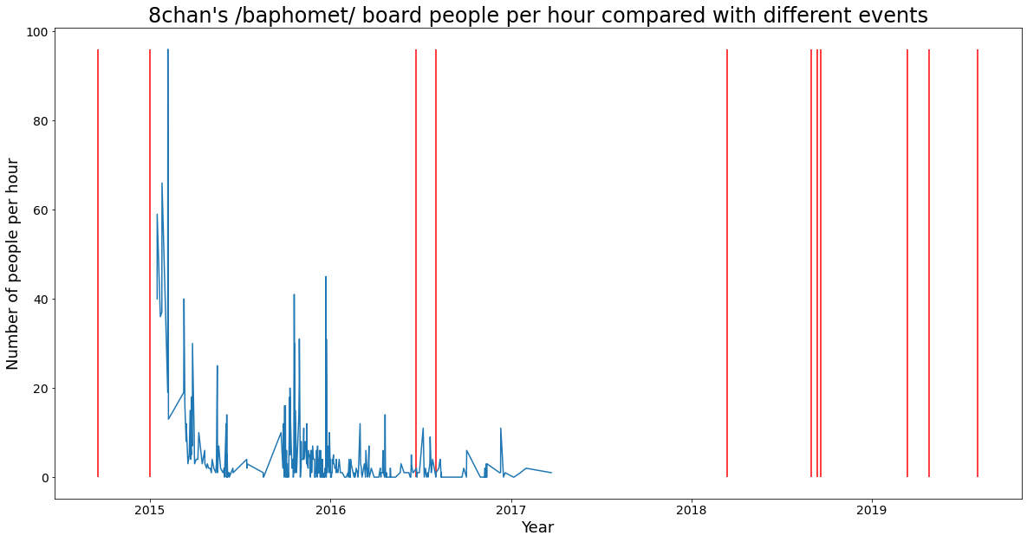
We see some spikes after the Swatting incidents, but a fall off in activity later
Christchurch
shooting
Louisiana
hoax
antifa
Poway
shooting
El Paso
shooting
Gamergate
Child Porn
Trump “Star of David”
QAnon
Swatting
Red lines indicate events.

Slide 29
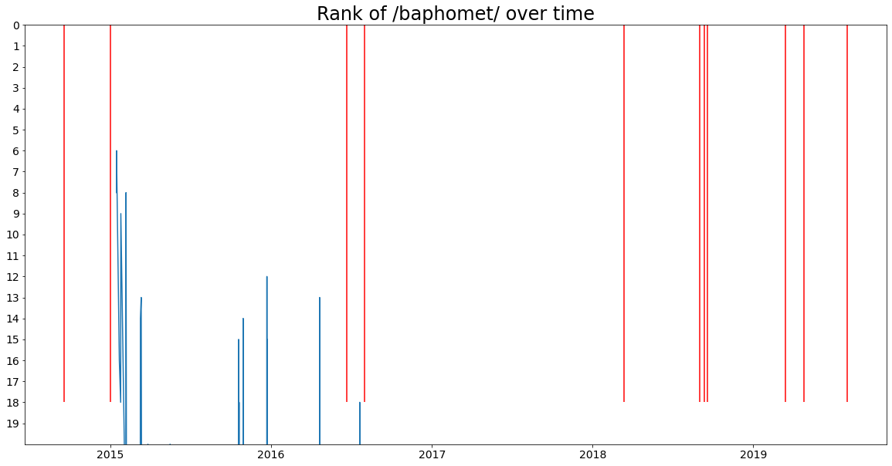
The rank of the /baphomet/ board on the also falls after the Swatting
Christchurch
shooting
Louisiana
hoax
antifa
Poway
shooting
Gamergate
Swatting
Trump “Star of David”
El Paso
shooting
Child Porn
QAnon
Board
Rank
on
Front
Page
Red lines indicate events.

Slide 30
For other events, I analyzed the most popular boards
Total Posts
People Per Hour
Board | Most Frequent Board Title | Highest total post count
/v/ | Video Games | 16,755,592
/pol/ | Politically Incorrect | 13,575,689
/b/ | Random | 8,894,540
/leftypol/ | Leftist Politically Incorrect | 2,961,756
/animus/ | Avatarfag Circlejerk | 2,459,384
/tv/ | Television and Movies | 2,111,526
/brit/ | /Brit/pol | 1,245,153
/homosuck/ | "Homestuck" General | 1,242,551
/tech/ | Technology | 1,083,644
/co/ | Comics & Cartoons | 1,069,553
Board | Most Frequent Board Title | Highest PPH Count
/pol/ | Politically Incorrect | 2450
/v/ | Video Games | 2412
/b/ | Random | 1318
/hga/ | The Hunger Games Avatar Roleplay Board | 738
/gamergate/ | Gamergate | 719
/4get/ | wew | 680
/ints/ | International Saloon | 629
/intl/ | International Lounge | 610
/hwndu/ | He Will Not Divide Us | 596
/leftypol/ | Leftist Politically Incorrect | 557

Slide 31
I had to do some additional work to determine the topics for some of these
Total Posts
People Per Hour
Board | Most Frequent Board Title | Highest total post count
/v/ | Video Games | 16,755,592
/pol/ | Politically Incorrect | 13575689
/b/ | Random | 8,894,540
/leftypol/ | Leftist Politically Incorrect | 2,961,756
/animus/ | Avatarfag Circlejerk | 2,459,384
/tv/ | Television and Movies | 2,111,526
/brit/ | /Brit/pol | 1,245,153
/homosuck/ | "Homestuck" General | 1,242,551
/tech/ | Technology | 1,083,644
/co/ | Comics & Cartoons | 1,069,553
Board | Most Frequent Board Title | Highest PPH Count
/pol/ | Politically Incorrect | 2450
/v/ | Video Games | 2412
/b/ | Random | 1318
/hga/ | The Hunger Games Avatar Roleplay Board | 738
/gamergate/ | Gamergate | 719
/4get/ | wew | 680
/ints/ | International Saloon | 629
/intl/ | International Lounge | 610
/hwndu/ | He Will Not Divide Us | 596
/leftypol/ | Leftist Politically Incorrect | 557
Right-wing politics
Right-wing politics
Left-wing politics
Anime
Getball Video Game
British politics
Non-English board
Homestruck Comic
International Politics
Against Trump
Left-wing politics

Slide 32
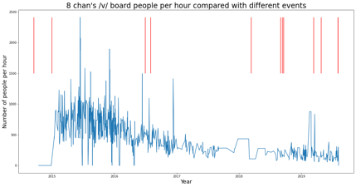
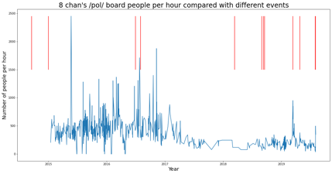
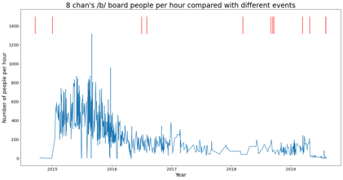
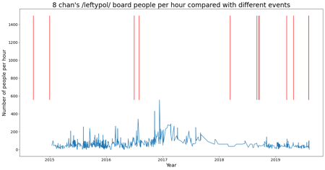






I visualized the PPH for the top 10 boards by total posts and mapped them to the events reported by Wikipedia
/v/
/pol/
/b/
/leftypol/
/animus/
/tv/
/brit/
/homosuck/
As reported by various news articles, /pol/ has spikes that correspond to some of these events.
/tech/
/co/

Slide 33


/pol/ has far more people per hour than /leftypol/ indicating that 8chan had more right-wing conversations
The y-axis scales do not match.
/pol/ (right) goes to 2500
/leftypol/ (left) goes to 1400
Red lines indicate events.

Slide 34

/pol/ has spikes around the Star of David picture, child porn, and the shootings
Louisiana
hoax
antifa
Christchurch
shooting
Poway
shooting
QAnon
El Paso
shooting
Gamergate
Swatting
Trump “Star of David”
Child Porn
Red lines indicate events.

Slide 35

Recall that /doll/ was reported as the board related to the child porn but we have no record of its existence
Instead we have a small spike a few days prior to 8chan being delisted from Google over child porn
Red lines indicate events.

Slide 36

After zooming in, we see some elevated activity in /pol/ after the “Star of David” image was posted
8chan user posts “Star of David”
Trump tweets “Star of David”
Red lines indicate events.

Slide 37

For comparison, we see little elevated activity in /leftypol/ 1 week prior to Trump’s tweet
8chan user posts “Star of David”
Trump tweets “Star of David”
Red lines indicate events.

Slide 38

If we look closer to the Christchurch shooting, we see that it is likely discussions on the shooting rather than activity leading up to the shooting
There are no mementos captured from the week leading up to the shooting.
Red lines indicate events.

Slide 39

There are so few mementos captured leading up to the Poway synagogue shooting that it’s hard to say that there is a spike on /pol/
Red lines indicate events.

Slide 40

It looks like the /pol/ conversation grew after the El Paso shooting, but not nearly as much as after the Christchurch shooting
Red lines indicate events.

Slide 41

Looking at the rise and fall of the rank of /pol/ does not seem to help, because it was almost always the highest ranked board
Louisiana
hoax
Antifa
Christchurch
shooting
Poway
shooting
El Paso
shooting
Board
Rank
on
Front
Page
If anything, it seems to fall in popularity near some of these events.
Trump “Star of David”
Red lines indicate events.
Gamergate
Swatting
Child Porn
QAnon

Slide 42

The /leftypol/ board never seems to rank first place
Louisiana
hoax
Antifa
Christchurch
shooting
Poway
shooting
Child Porn
El Paso
shooting
Swatting
Board
Rank
on
Front
Page
Red lines indicate events.
Trump “Star of David”
Gamergate
QAnon

Slide 43
What is this? The largest spike in people per hour for /pol/ does not correspond to an event mentioned by Wikipedia.
What happened on May 23, 2015?
I found no mementos for /pol/ on that date.
Red lines indicate events.

Slide 44

Does the conversation change around an event compared to the rest of /pol/?

Slide 45
Methods
I ran Memgator to find any and all mementos associated with http://8ch.net/pol/
I downloaded the mementos while honoring 503s and retry-after headers
I removed boilerplate with boilerpy3
I computed Jaccard distance between the memento on the date of the event and other mementos from /pol/
 | Count
Mementos reported | 4569
Failed Downloads | 317
Non 200 Status | 7
Successful Downloads | 4245

Slide 46

Very few terms overlap between the /pol/ pages around Trump’s ”Star of David” and pages farther into the future or past

Slide 47

Very few terms overlap between the /pol/ pages around the Christchurch shooting and pages farther into the future or past

Slide 48

Very few terms overlap between the /pol/ pages around the El Paso shooting and pages farther into the future or past

Slide 49

∞chan is dead, long live 8kun!
On October 7, 2019, Jim Watkins rebranded 8chan as 8kun
the –chan suffix typically indicates something diminutive in Japanese, often interpreted as relating to children or young girls
the –kun suffix is reserved for young men in Japanese
8kun moved to 8kun.top in November 16, 2019 after Tucows terminated their domain registration contract
8kun is available on clearnet and Darknet
Brennan opposes 8chan’s reincarnation as 8kun, believing ”imageboards are more trouble than they’re worth”

Slide 50
Future work
Did /leftypol/ consist of legitimate conversations, or were right-wing users masquerading as leftists?
Why is there a spike in activity for /pol/ on May 23, 2015? Is there any way we can determine why this may have happened?
How do the conversations on /pol/ compare between an 8chan baseline and the conversation around the event?
Why did /pol/ drop precipitously in rank several times?
With new events, what will a similar analysis of 8kun show us?
Why do the different captures of /pol/ share so few terms?
Any NLP conducted on the boards may need to consider the language used by different groups, which often includes slang and community-specific terms.

Slide 51
Summary and Conclusions
There are some spikes in activity around these events:
Swatting incidents on /gamergate/ and /baphomet/
Trump’s “Star of David” on /pol/
Child Porn on /pol/
Christchurch on /pol/
El Paso Shooting on /pol/
The /leftypol/ board is popular, but never as popular as the /pol/ board, indicating that the 8chan community leans rightward.
Web archive samples of 8chan are incomplete making it difficult to see if there is more activity leading up to the event
Measuring the differences in rank over time do not help because the boards of interest are usually the most popular and do not drop in popularity that often.
We notice a spike, but often after the event, likely due to an interest in archiving 8chan after one of these events occurs.

